Slide 1
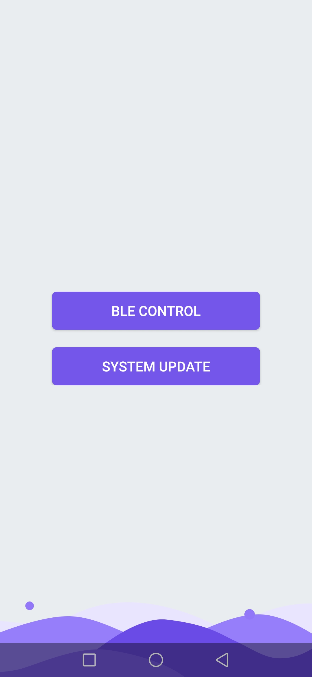
Solar Street Lights
LO
GO
APP OPERATION INTRODUCTION
请输入公司名称
The company name
R & D team
2020.06.23

Slide 2
CATALOG
01
02
03
APP
Overview
APP
Product Function
APP
New Function

Slide 3
PART ONE
APP Overview

Slide 4
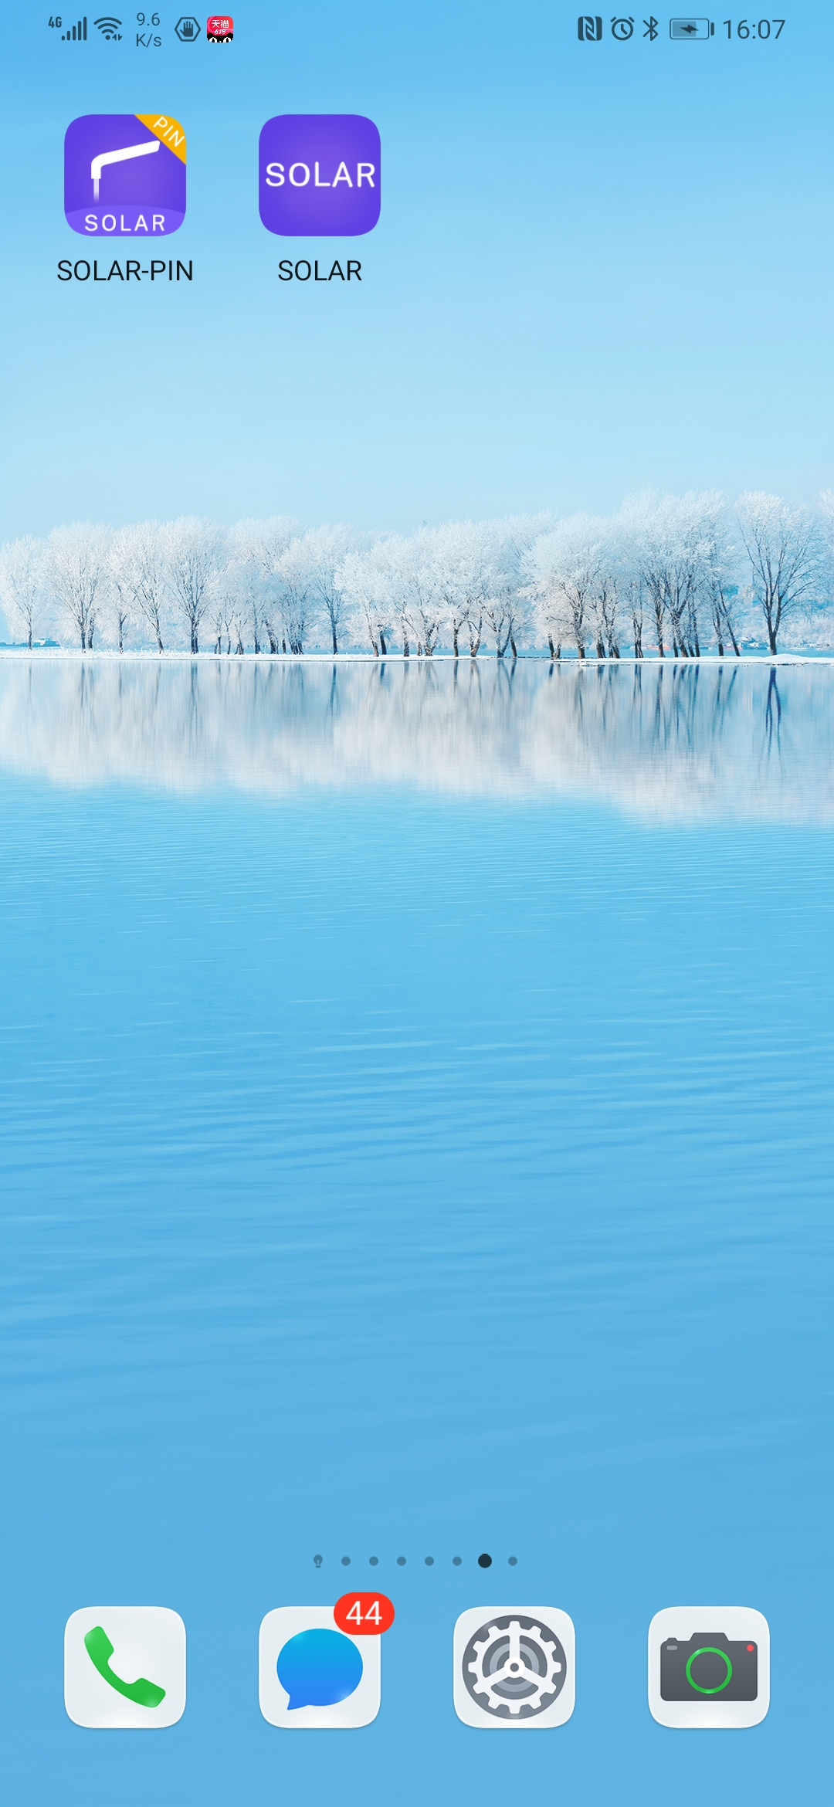
APP Overview
Professional
Overview
Fast
Efficient
APP name: "SOLAR" and "SOLAR-PIN“
Brief introduction: “SOLAR” is a mobile app independently developed by us and designed to be used in conjunction with our solar street lights. “SOLAR-PIN“ is the same version App but just with encryption processing, so as to limit the operation of App.
Compared with the previous version, this new version APP adopts a brand-new UI designed interface, and remains the functions of the old version, and adds new functions like group networking control, etc.

Slide 5
Updates of new version App
UI interactive interface
APP interface UI is redesigned with popular label modular, which improves user's sensory interaction and operation experience.
Networking group control
Each solar street light is equipped with a Bluetooth networking module. They autonomously establish a local area network for device communication. By connecting with only one of the lights, user can control all the other lights in the group.
Support dynamic personalized name
New App adopts the method of dynamically configuring the name. By adding the corresponding product names in the database, they can be searched and displayed on App interface, no need to revise the app as the old version.

Slide 6
PART TWO
APP
Product Function

Slide 7
APP
Product function
View device information
1. View lighting statistics 2. View real-time data 3. View historical data
Search & connect devices
1. Common device 2. networking device
Check update
1. Check new version
2. Download and install new version App
Other functions
1. Troubleshooting 2. About equipment
3. Restore factory settings
Device settings
1. Control light switch 2. Adjust light brightness 3. on/off switch 4. Infrared motion sensor switch
5. Video surveillance switch 6..Indicator switch 7. Indicator mode

Slide 8
APP Function—Welcome page
Welcome page
When open the APP, the first page displayed is danamic.
User can click the enter button in the upper right corner to skip to APP homepage.

Slide 9
APP Function—Home page
Home page
User can click the "Bluetooth Control" button to search and connect device; or click the “System Update" button to check updated version.

Slide 10
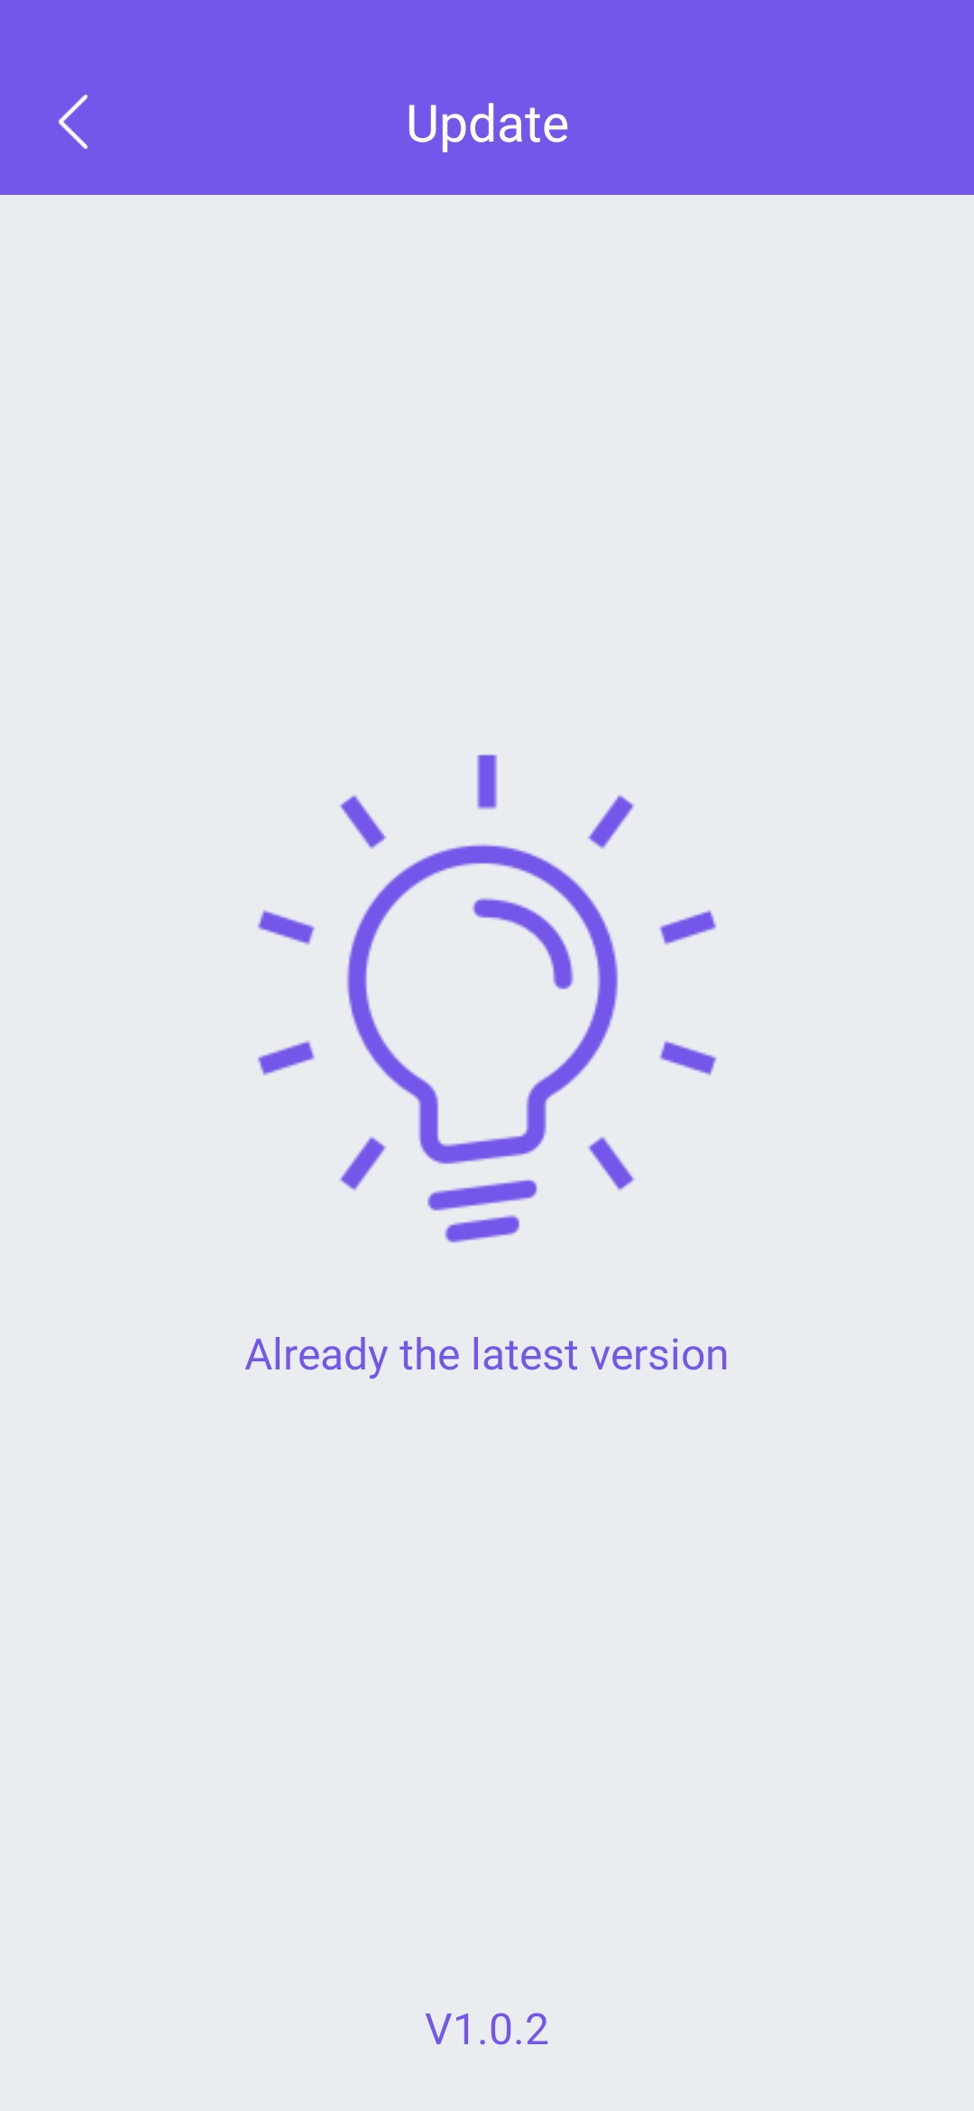
APP Function—Check update
Check update
When enter the page, APP will automatically check if there is a new version. If so, click the download button to download and install the latest App version. If it is already the latest version, it will remind by a notice.

Slide 11
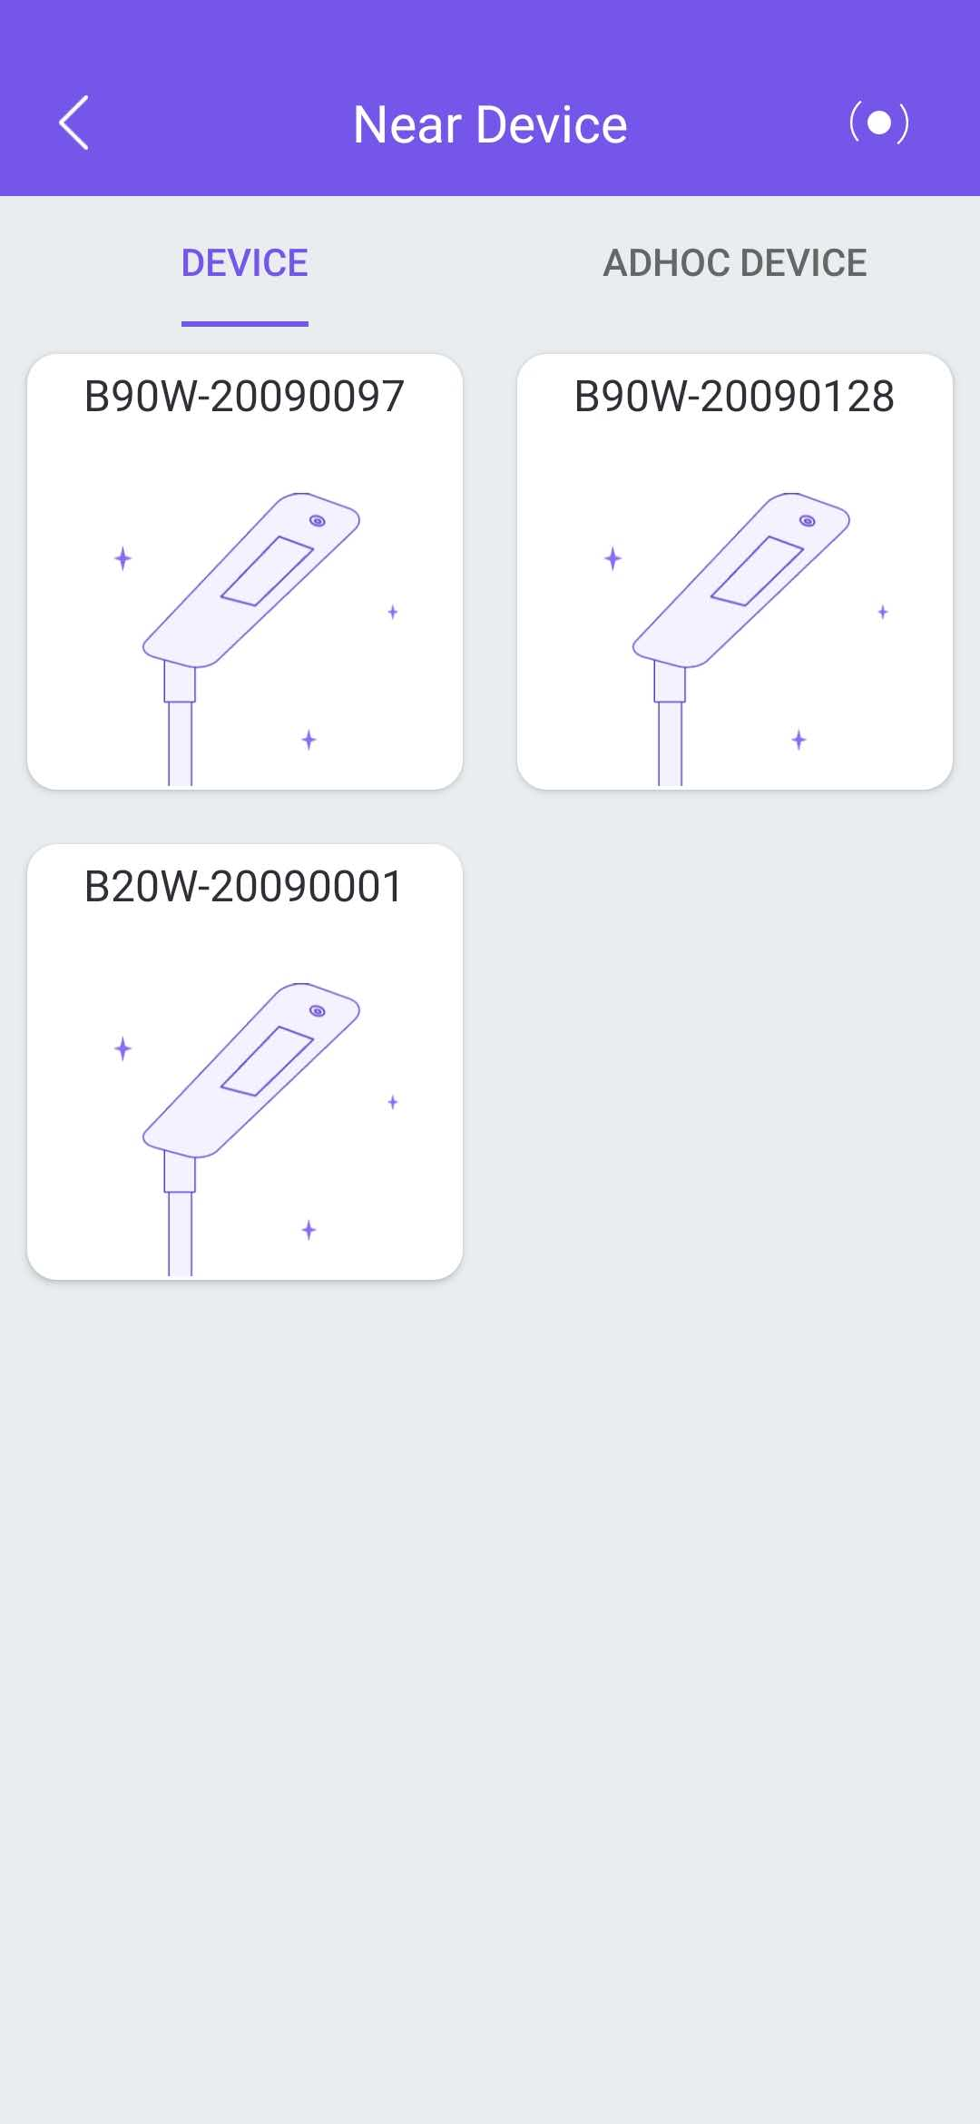
APP Function—Search and connect device
Search and connect devices
After entering the page, APP will search for near devices via Bluetooth. There are two types of equipment, namely "non-networking equipment" and "networking equipment". APP will automatically judge which type it is and display it on the corresponding tab page. User can click the tab to view the searched device icon. When user click the icon, the selected device will be connected.
Note:
1. Android 6.0 and above systems have permission verification, so the device can be searched only after user authorizes the corresponding permission.
2. Android 6.0 and above systems require the user to turn on the location service when using Bluetooth search, otherwise the device cannot be searched.
3. If the device is unable to be found after named with a user-defined name, please confirm the user-defined name has been sent to our engineer in advance, and ensure mobile network is available. Because the filter conditions for displaying devices are dynamically obtained from the server.

Slide 12
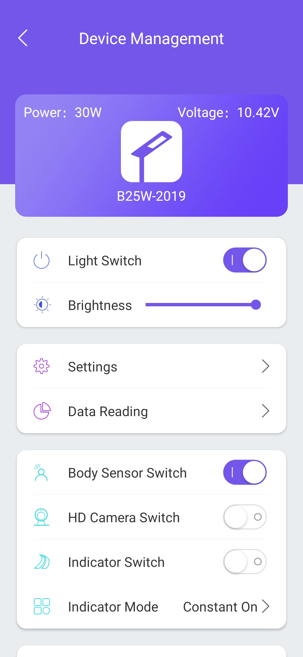
APP Function—Control and reset non-networking devices
Control and reset non-networking devices
After entering the page, the device information of power, voltage, name, and switch status is displayed.
Users can perform the following operations on this interface:
1. Control light switch;
2. Adjust light brightness;
3. Set light working mode (time switch, light switch, time frame mode);
4. View device data (lighting statistics, parts real-time information, historical information);
5. Control human body infrared sensor switch;
6. Control video surveillance switch;
7. Control road indicator switch;
8. Conduct preliminary troubleshooting;
9. View information about device;
9. Restore factory settings.

Slide 13
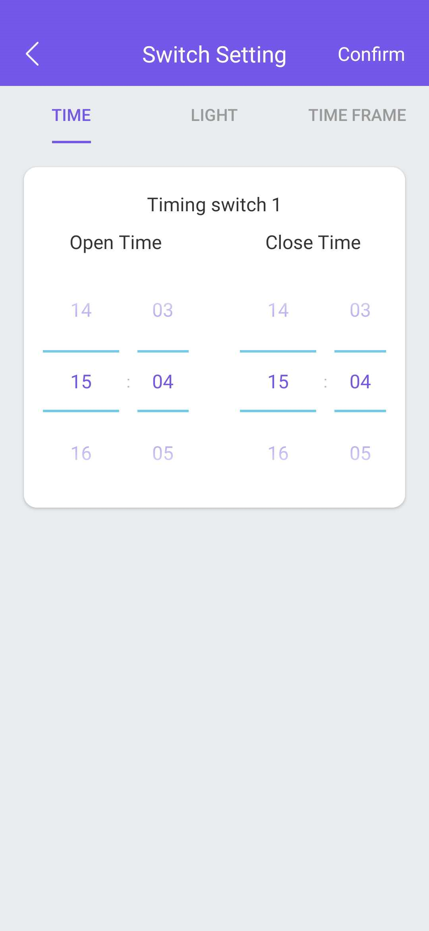
APP Function—Switch setting—Time switch setting
Time switch setting
User can slide the time selector to set turn-on time and turn-off time, then click "OK" button in the upper right corner.

Slide 14
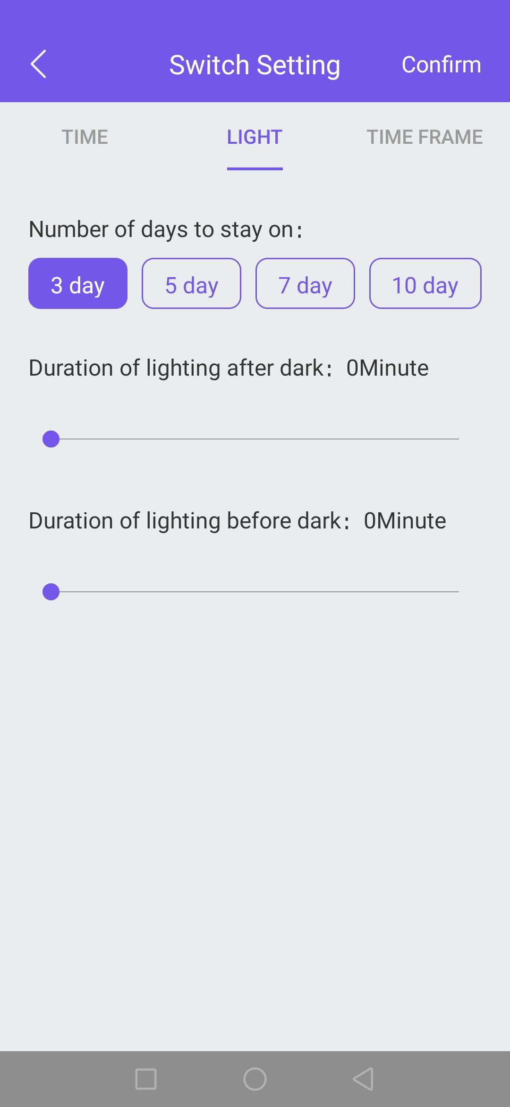
APP Function—Switch setting—Light switch setting
Light switch setting
User can configure the light brightness by setting the backup days, and the lighting durations in the night can also be set. After setting is completed, click "OK" button in the upper right corner.

Slide 15
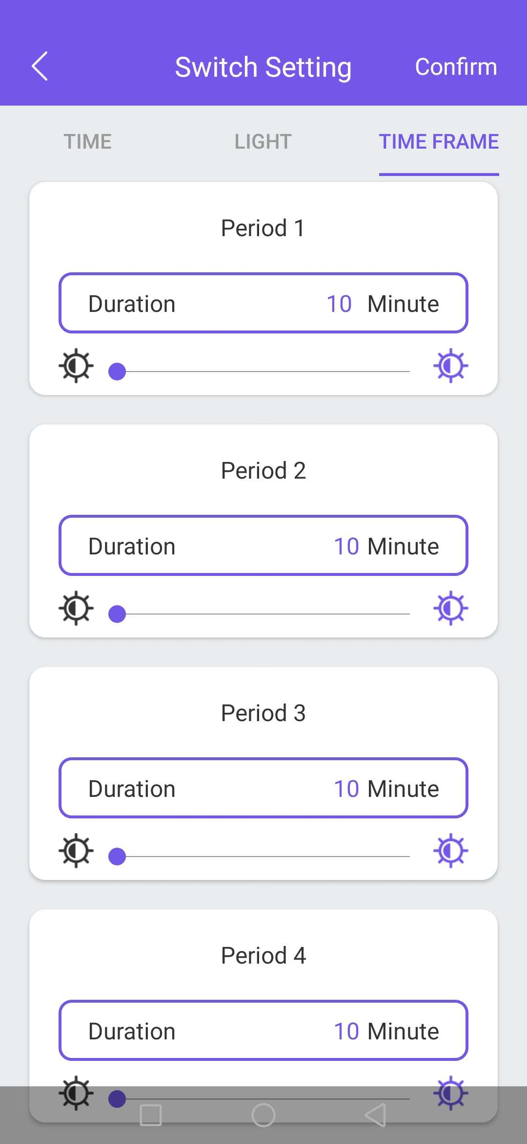
APP Function—Switch setting—Time frame setting
Time frame mode
User can configure the light working period and the brightness percentage of each period. There are 5 periods in total. After setting is completed, click "OK" button in the upper right corner.

Slide 16
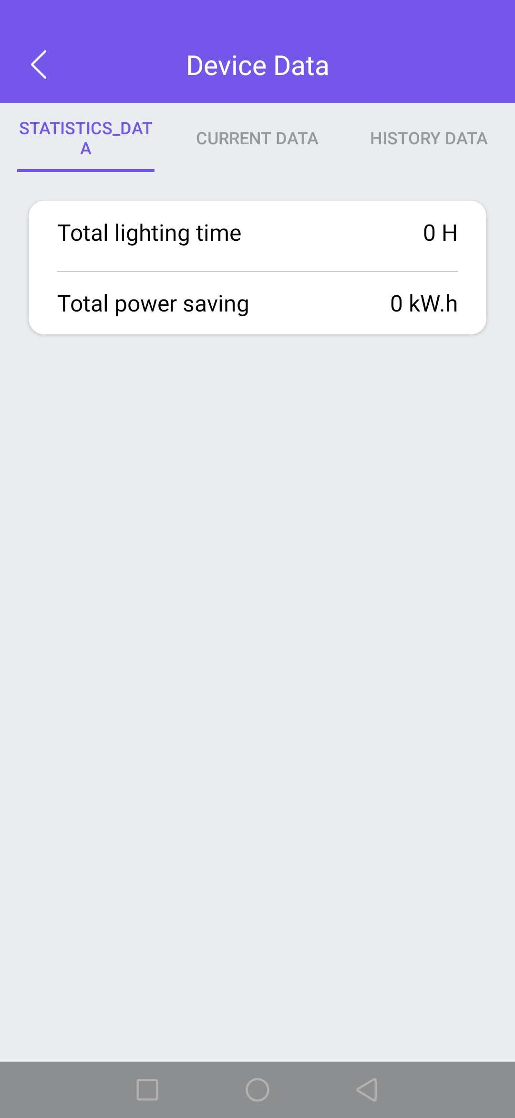
APP Function—Device data—Statistics data
Statistics data
It shows the current device’s lighting statistics like total lighting time and total power saved.

Slide 17
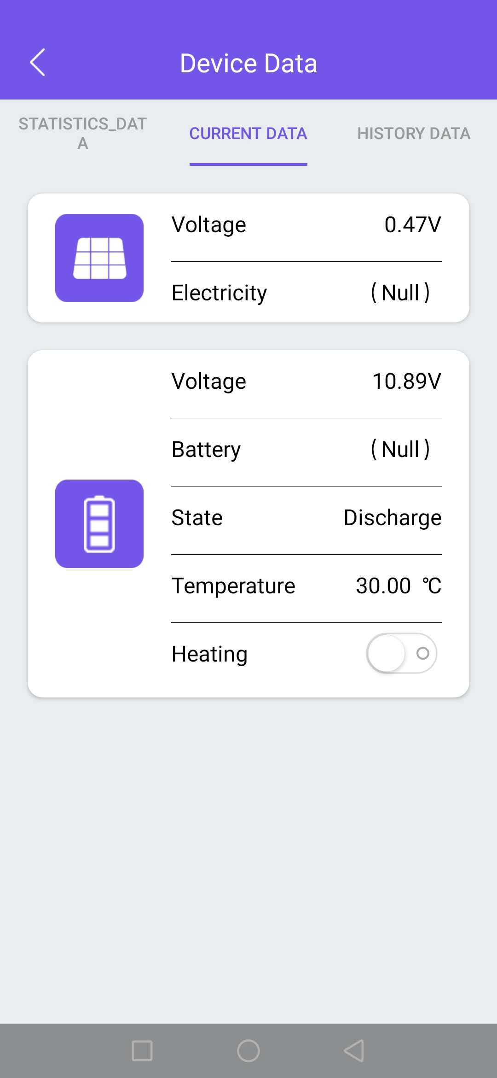
APP Function—Device data—Current data
Current data
It shows the device current data like solar panel voltage, battery voltage, working status, temperature, etc.

Slide 18
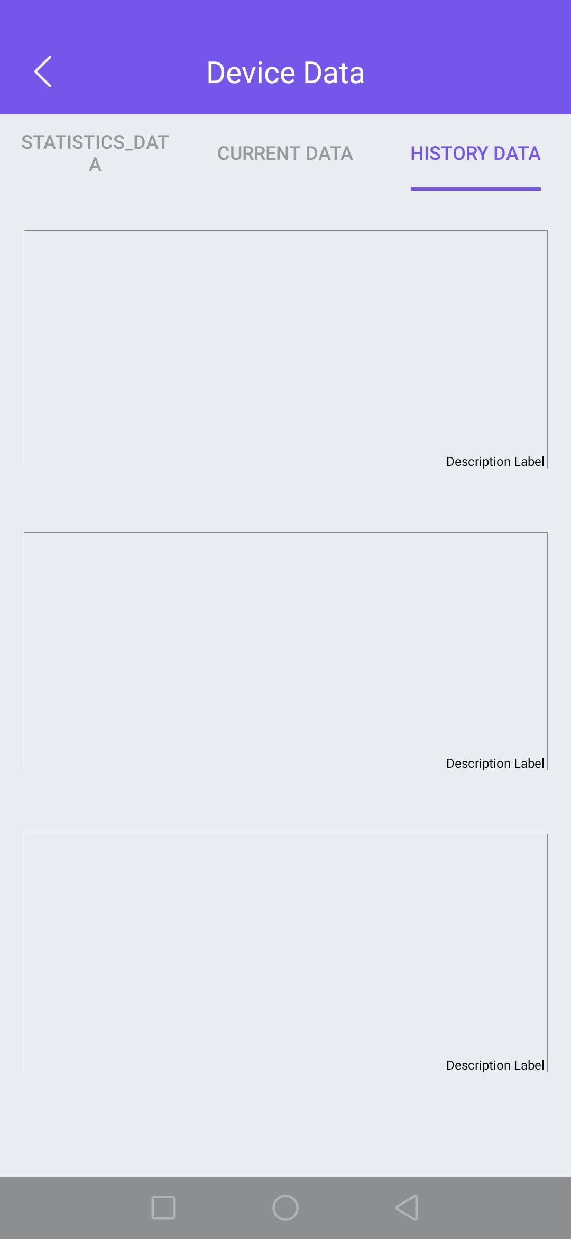
APP Function—Device data—History data
History data
It shows the device history data like battery voltage, solar panel current, battery temperature… at some past time.

Slide 19
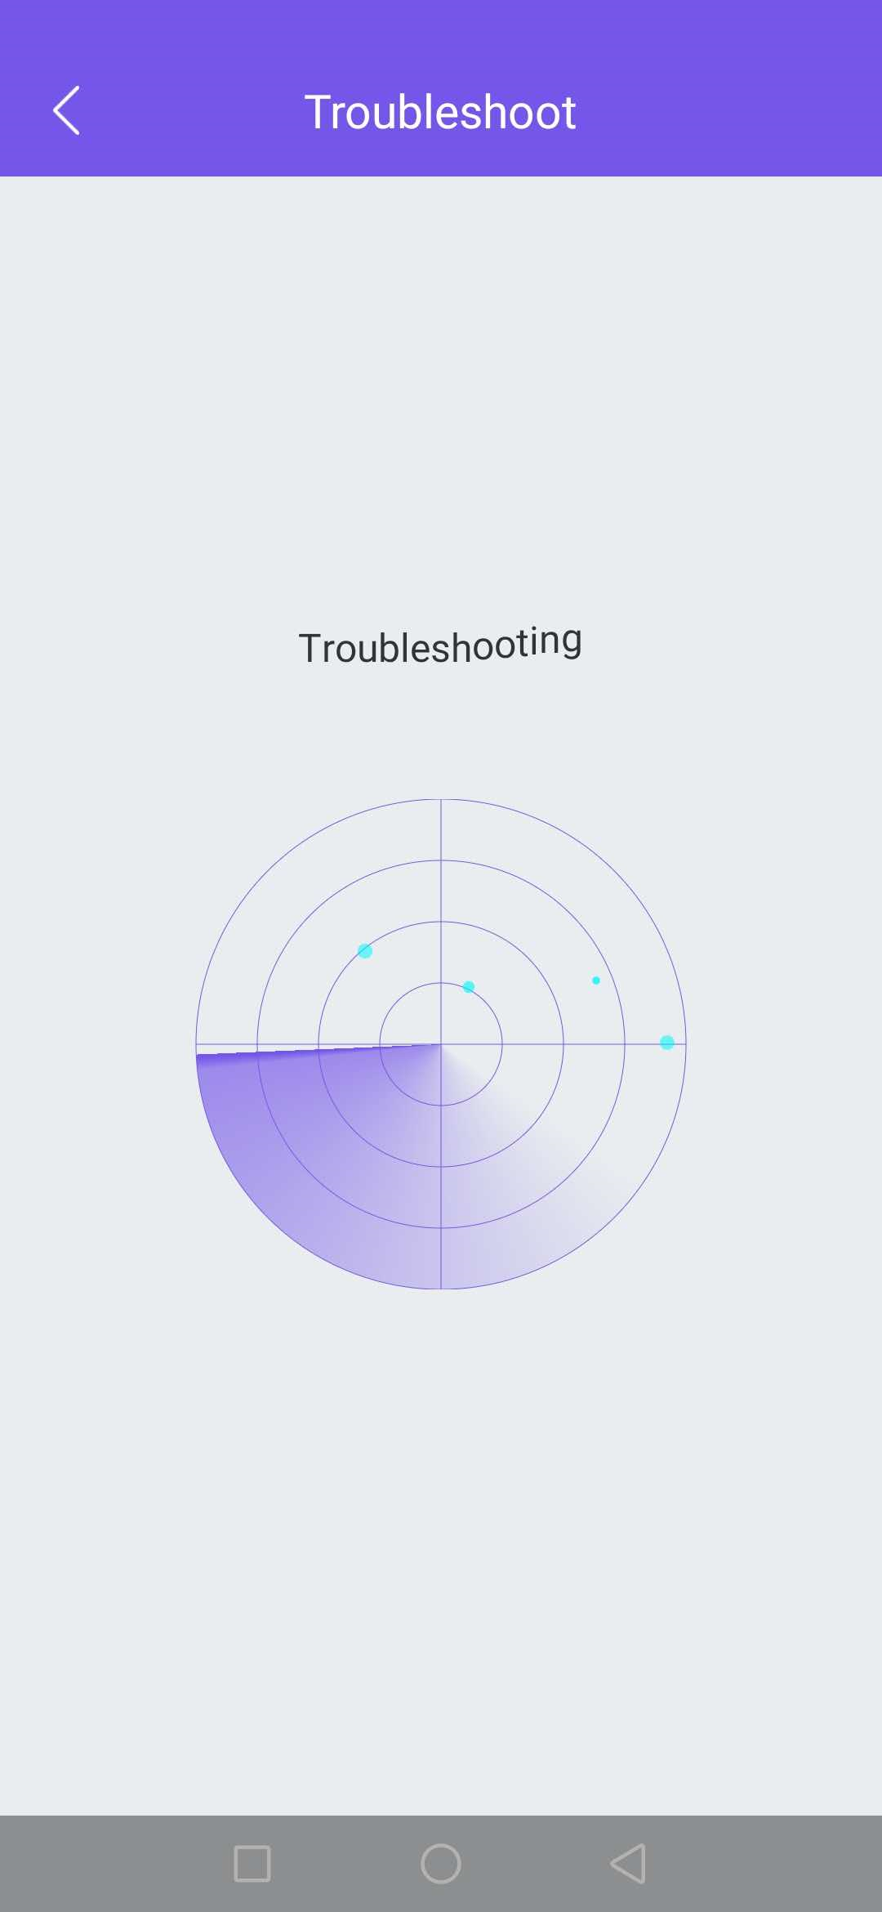
APP Function--Troubleshooting
Troubleshooting
Once enter into this page, App will automatically troubleshoot the problem of the connected device.

Slide 20
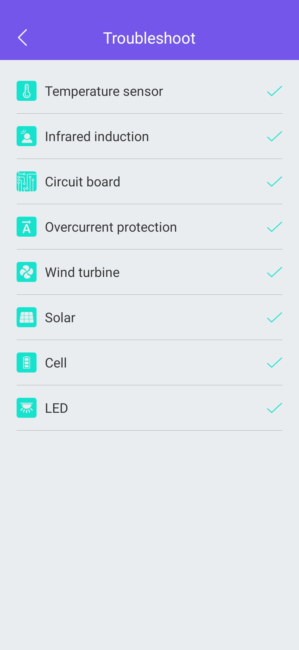
APP Function--Troubleshooting results
Troubleshooting results
It will mark the failure part once it is detected, and tick the good part if no fault is detected.

Slide 21
APP Function—About device
About device
The page shows some information about the App version.

Slide 22
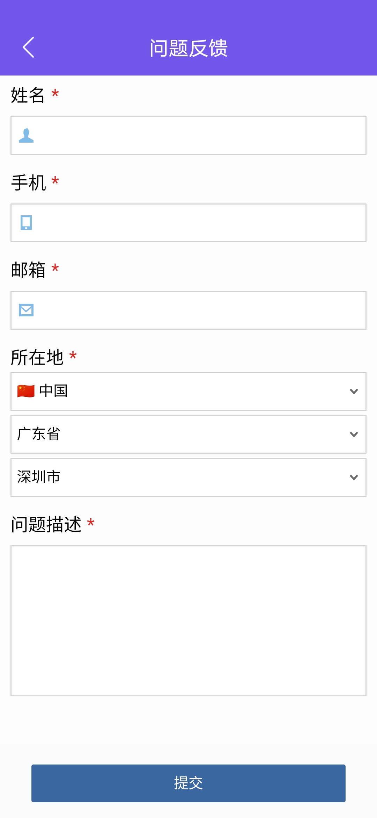
APP Function—About device—Problem feedback
Problem feedback
This page is convenient for users to provide feedbacks. After filling, just click "Submit" button.

Slide 23
APP Function—About device—Version information
Version information
This page shows the device version and the App version information.

Slide 24
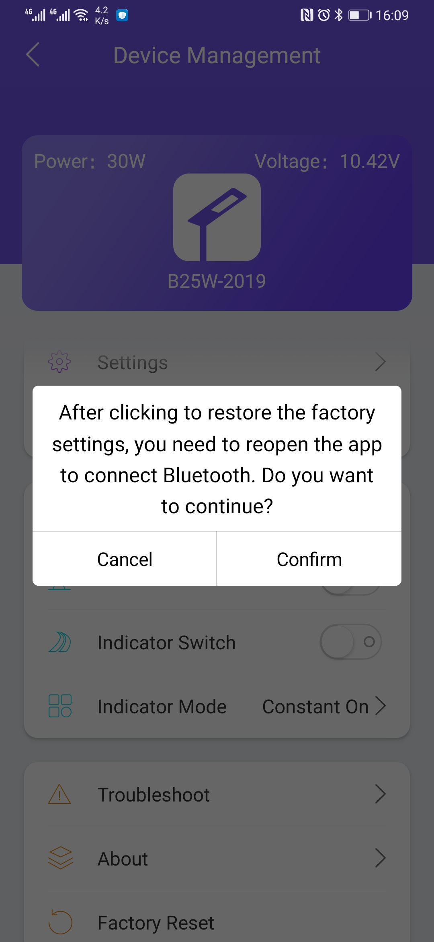
APP Function—Restore factory settings
Restore factory settings
Once click “restore factory settings”, it will pop up 2 options: confirm and cancel.

Slide 25
PART Three
New Functions

Slide 26
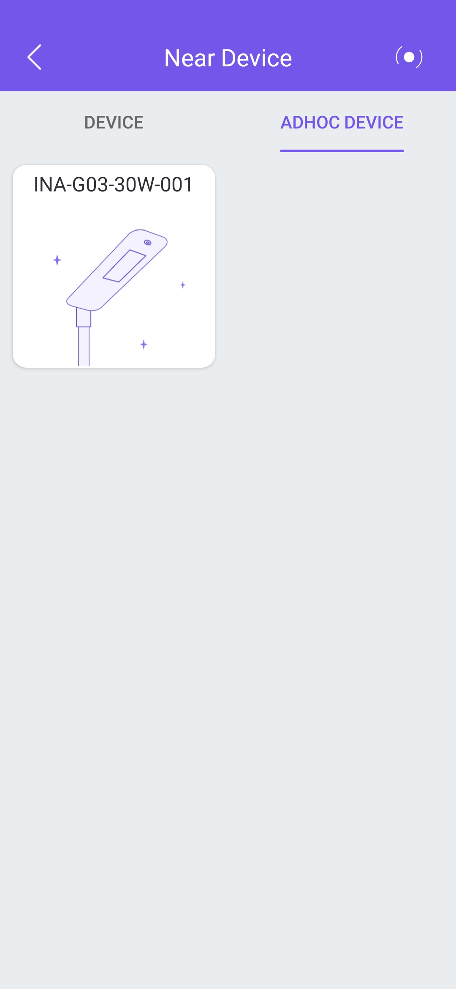
New Functions—Networking device list
Networking device list
Click “Adhoc device" tab then switch to the networking device list page, they are named temporarily starting with "INA". Click any networking device, you will enter the sub-device page for operation.

Slide 27
New Functions—Networking sub-device list
Networking sub-device list
This page shows how many devices are in the networking group, you can select any sub-device for operation, or not select. If no selection, then all devices are operated by default. Click "device management“ then enter the management page; click "view data“ then view the device’s data.

Slide 28
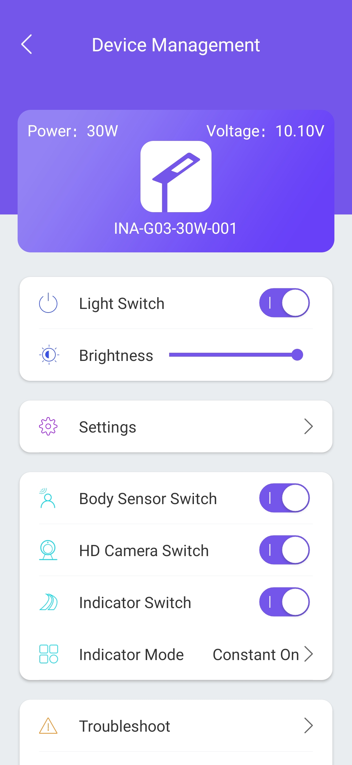
APP Function--Control and reset networking devices
Control and reset networking devices
After entering the page, the device information of power, voltage, name, and switch status is displayed.
Users can perform the following operations on this interface:
1. Control light switch;
2. Adjust light brightness;
3. Set light working mode (time switch, light switch, time frame mode);
4. Control human body infrared sensor switch;
5. Control video surveillance switch;
6. Control road indicator switch;
7. Conduct preliminary troubleshooting;
8. View information about device;
9. Restore factory settings.

Slide 29
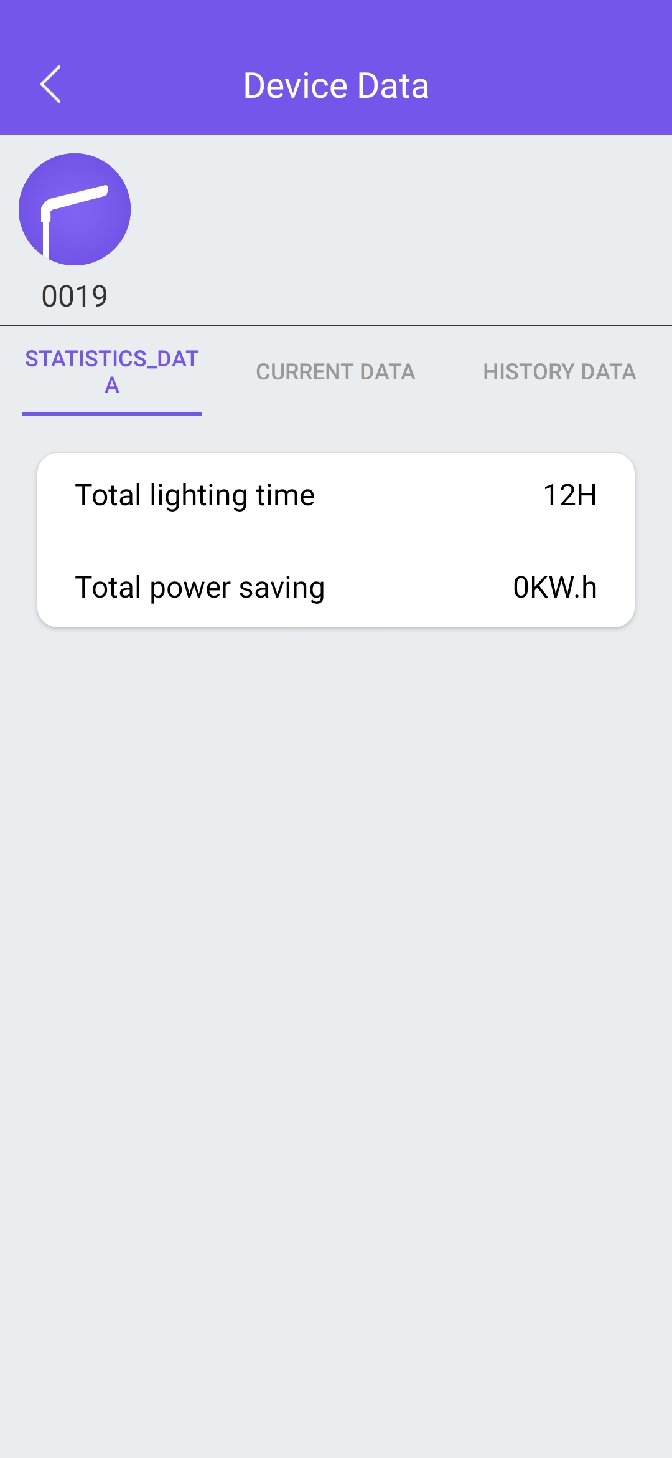
New Function—View networking device date
View networking device data
On this page, users can slide the networking device list under the navigation bar to find the sub-device to be viewed, and click to view its information. You can view different data by clicking different information labels.

Slide 30
LO
GO
Thanks for watching
LO
GO
请输入公司名称
The company name
请输入公司名称
The company name

